Slide 1
Git(Hub) 101
- Stijn & Merlijn

Slide 2
Glossary
Git and GitHub: Git is an open-source, change-tracking program, and GitHub is a site/solution built on Git. There are other websites and solutions that use Git as their backend. You can have unlimited public and private repositories for free. Paid products are available for extended features.
Repo or Repository: Each project in GitHub is in a repository, or repo. A repo contains all of a project’s files, including documentation, and it supports revision history. A repository can be public or private, and you can have a local copy of the repo on your computer hard drive, or you can use the repo within GitHub.
Branch: This is a copy of a repository that resides in the same repository as the original. You can merge a branch with the original.
Fork: This is a copy of another repo that resides in your GitHub account, in comparison to a branch, which lives in the original repo.

Slide 3
Glossary
Issue: Suggested improvements, tasks or questions related to the repository. Issues can be created by anyone (for public repositories), and are moderated by repository collaborators. Each issue contains its own discussion forum, can be labeled and assigned to a user.
Push: This is the process of sending or submitting your local changes to the online repo.
Pull request: This is a set of proposed changes to a repo that a user submit, and a repo’s owners or collaborators then can accept or reject the pull request.
Commit: A commit, or "revision", is an individual change to a file (or set of files). It's like when you save a file, except with Git, every time you save, it creates a unique ID (a.k.a. the "SHA" or "hash") that allows you to keep record of what changes were made when and by who. Commits usually contain a commit message which is a brief description of what changes were made.

Slide 4
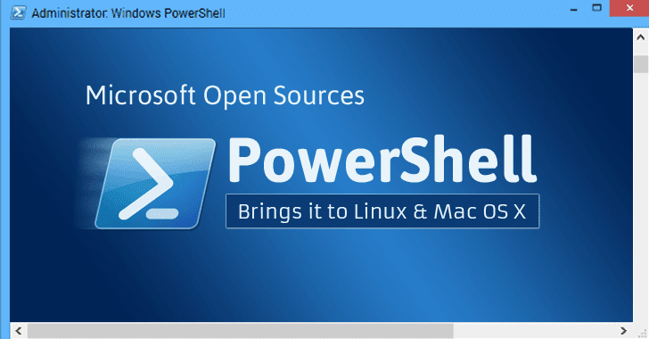
Why
Collaborate
Improve
Peer review
Version control
Forks and branches
OPEN SOURCE
Notes:
Did you know PowerShell is open sourced?
Since v6
No longer Windows PowerShell
cross-platform (linux, Mac)
PS 7 is full of community contributions

Slide 5
DEMO
Hello World
https://guides.github.com/activities/hello-world/
Notes:
https://guides.github.com/activities/hello-world/
Let’s create a BEPUG repo
Create readme.md
Add a .ps1 file with some basic code
“Hello world”
Create new branch NEEDS-IMPROVEMENT
Add code, commit
Create pull request
Review diffs
Merge

Slide 6
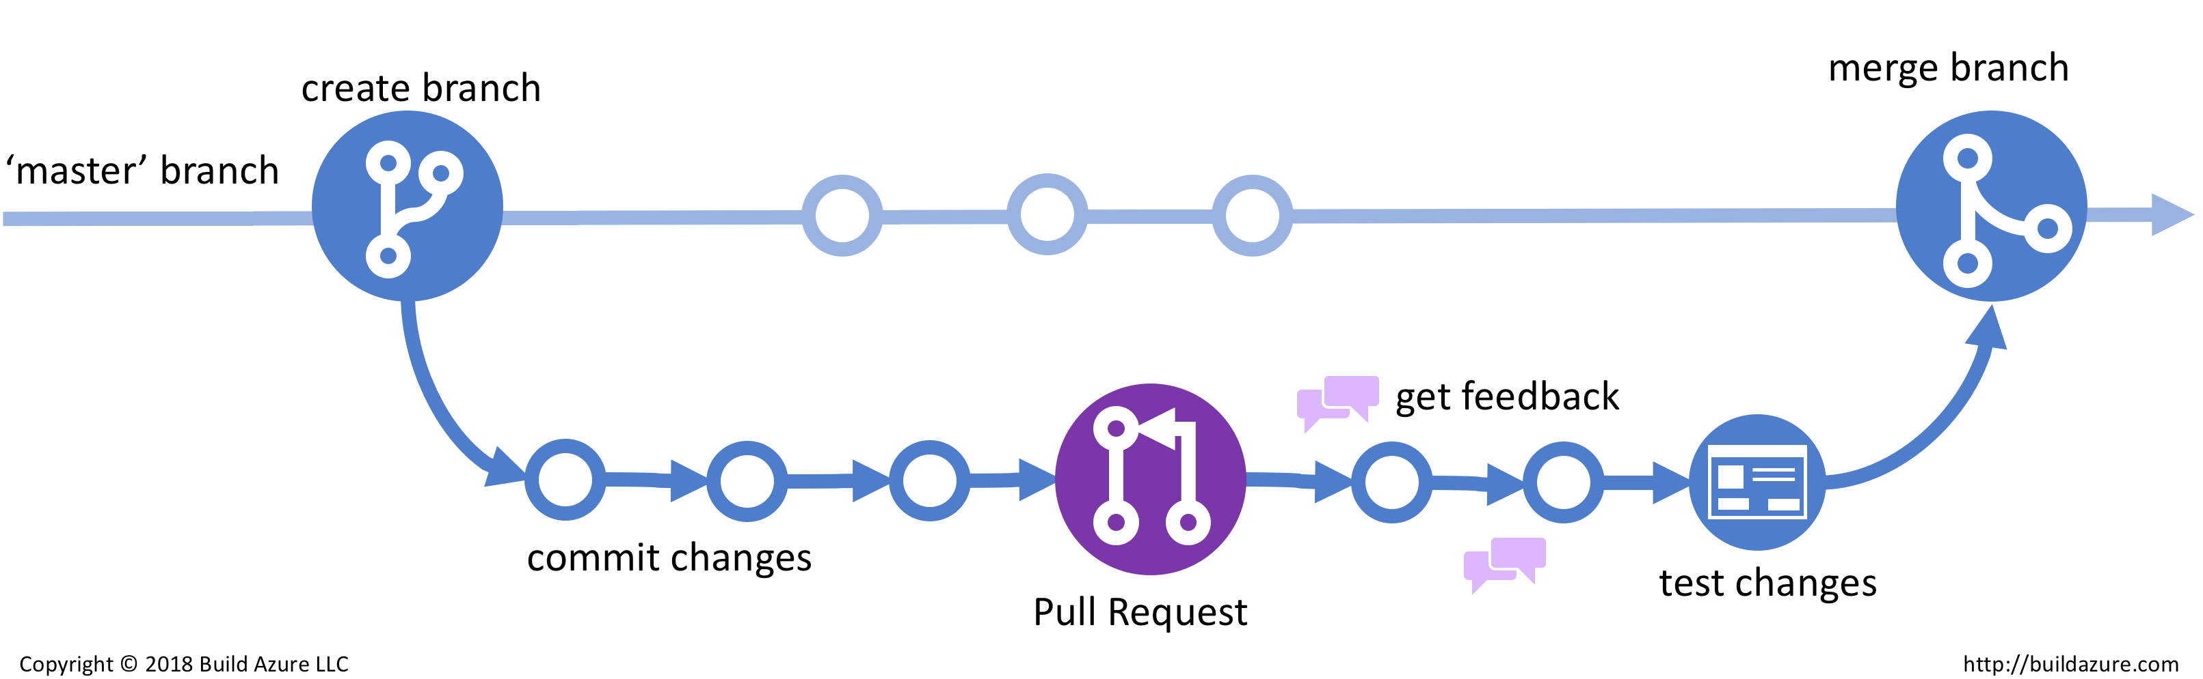
GitHub Flow
Notes:
Click image to open site. Show and explain the GitHub flow = simple process for development collaboration.

Slide 7
DEMO
GitHub Pages
https://guides.github.com/features/pages/
Notes:
https://guides.github.com/features/pages/
Let’s show how the BEPUG site is built and maintained

Slide 8
Using GitHub for documentation
Best example: docs.microsoft.com
Uses Markdown
https://guides.github.com/features/mastering-markdown/
https://daringfireball.net/projects/markdown/
Improve documentation
Fix spelling and grammar
Fix wrong URL links
Rewrite to clarify
Notes:
Show docs.Microsoft.com and click through to the PowerShell overview
https://docs.microsoft.com/en-us/powershell/scripting/overview?view=powershell-7
Click Edit (top right)
Click Edit again (pen icon)
Talk about the fork that’s created when you don’t have write access
Show the Markdown syntax
Show issues, pull requests
Go back to docs.microsoft.com
Find any page to make changes to
Click the dropdown at the bottom to leave feedback directly on GitHub
Show how an issue is auto-created
Optional: show commits made to ConfigMgr docs by merlinfrombelgium

Slide 9

DEMO
It’s YOUR turn now!
Notes:
Let’s set up a repo on BEPUG
Enter some clear typos in readme.md
Create a .ps1 with easy to find syntax errors
Ask audience to find and fix some errors through commits, issues, pull requests, whatever
Let them learn

Slide 10
Free Git(Hub) clients on Windows
GitHub Desktop
Visual Studio Code (extensions)
https://git-scm.com/download/gui/windows
Quick demo
Notes:
Did you know… Visual Studio Code is open sourced as well?
https://github.com/microsoft/vscode

Slide 11
Things to know
git does not handle large files well ( > 2 GB – check out git LFS)
Collaboration is not real-time
git commands are plenty and not intuitive
- stick to GitHub and GUI clients until you’re comfortable to learn more
GitHub is free for individuals and open source purposes
Subscription plans for organizations
Consider alternatives like GitLab
GitHub is not considered very secure

Slide 12

Now go and learn!

